Slide 1
Arduino to MATLAB through Wi-Fi
Disclaimer: Information here might be wrong, I don’t know anything about servers or TCP/IP communication

Slide 2
Basic idea
Server ( telnet)
Hotspot in your phone
Read and write
Read and write
Arduino Giga
Laptop (client)

Slide 3
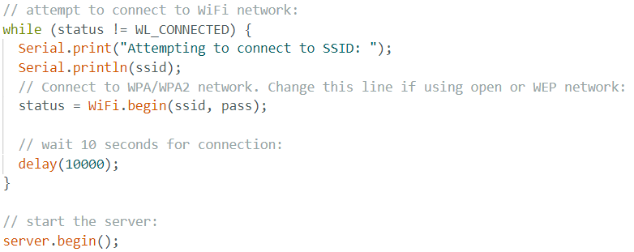
Arduino to Wi-Fi
Use Wi-Fi hotspot on phone
Use WIFI library (examples)
Library link
Should be in the board manager but just in case (link) (install board package)
I also used this video, in case something is not working
Learn how it works from sample code, here is the most important code:
Your phone’s hotspot id and password

Slide 4
Type of communication
TCP/IP (if this means something to you)
It uses telnet (NEED TO ACTIVATE activation)
Creates a server and clients can join it
Important information to connect
To connect you need the port (always 23)
and the IP address (sample code has a print statement when Arduino is connected)

Slide 5
Laptop to telnet
Simplest way to check is write in the cmd: telnet “IP Address”
Sample code should print “There is a new client”
There are many ways to communicate with telnet that I don’t know but luckily
MATLAB has an add-on for it (Instrument Control Toolbox)
MATLAB library Link
Specially look at client section
Need Port 23 and IP Address that should be printed in the Arduino serial monitor
Learn how to send and receive information
I have a VERY basic MATLAB code to test this:
Yes, the whole program is two lines

Slide 6
I just made the basic program to communicate now you need to figure out how to use this to send and receive information and what part is the laptop and Arduino going to do

